Slide 1
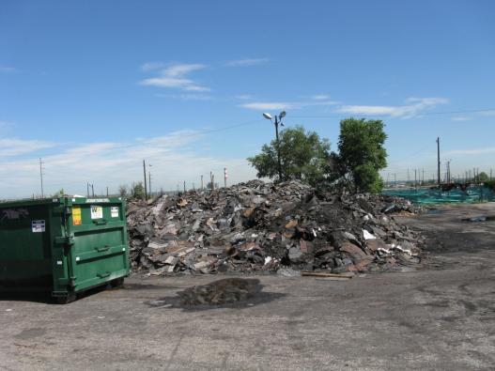
Waste Asphalt Shingles & Dealing with Sham Recyclers
Wolf Kray
Colorado Department of Public Health & Environment

Slide 2
Background
Emerging interest and market of recycled asphalt shingles developing in Colorado during 2010
CDPHE working with major landfill operator to develop criteria for shingle recycling standards to promote beneficial use of the material
Major damage sustained to metro area from the severe hail storm in May of 2010 with over $70 million in damage and over 13,000 insurance claims (KMGH)
EPA Region 8 & Boulder County staff were also trying to develop shingle recycling efforts locally

Slide 3
Recycling Facility Regulations
Recycling operations must register with the Department
Allowed a 1 year initial accumulation period to stockpile materials
Material turnover requirement of at least 75% of recyclables received over a 3 year average
Prevent nuisance conditions & offsite debris

Slide 4
Limitations by Colorado Revised Statute
A certificate of designation (permit) is not required or allowed to be required for recycling operations that do not constitute solid waste disposal
Financial assurance is not be required for facilities operated for the purpose of processing recyclable materials

Slide 5
Shingle Recycling Standards Adopted
To ensure the protection of human health and the environment regarding asphalt shingle recycling, such operations shall include:
1. Testing for asbestos using a representative sample in the finished ground product at a frequency of approximately one sample for every 500 tons.
2. Records of laboratory testing data shall be kept on site and available for review during inspections.
3. Proper management and disposal of any loads of shingles testing positive for asbestos greater than 1% by weight of a composite sample at an approved asbestos landfill.
4. Addition of water or other engineering controls during the grinding process to minimize the potential for release of particulate emissions.
5. Use of perimeter ditches and or soil berms to prevent storm water run-on from the storage and processing area.
6. Storm water run-off retention prior to discharge and the installation and proper maintenance of sediment removal devices along the run-off perimeter of the storage and processing area.

Slide 6
New Market, New Players
New players to the recycling universe, unfamiliar with the regulations and requirement to register with the solid waste program
Following the major storms, many of the shingle recyclers were from out of state and either unfamiliar with the regulations or were purposely flying below the radar
Waste shingle market quickly became over saturated
High volume of material collected in short period of time
Low demand & minimal end-use available
resulting in a bottleneck of material stockpiled
CDOT: Reclaimed Asphalt Shingles (RAS) are allowed in hot mix asphalt (HMA) up to a maximum of 5 percent for all lifts provided all specifications for HMA are met. Section 401

Slide 7
Recycling, or Illegal Disposal?
Tipping fee at shingle “recyclers” much less then landfill tipping fees resulted in lots of patrons and tonnage stockpiled
High collection rates of waste shingles but little or no processing occurring at sites

Slide 8
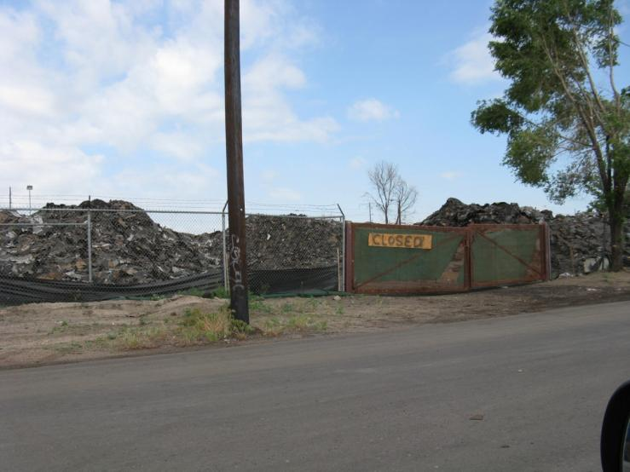
New Facilities…

Slide 9
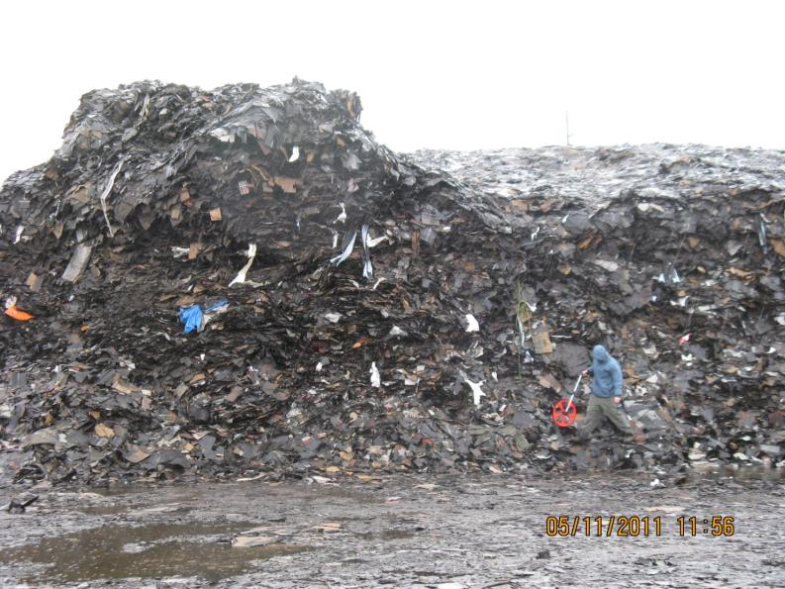
“Shingle Mountain”

Slide 10
Shingle Mountain Case
2010
February - Facility opens (unregistered)
May Major hailstorm
July - Facility stops receiving shingles
August - Issued zoning citation from the county
September - Registered as a recycler with CDPHE
2011
Jan.- March Grinding operations occur until grinder is repossessed
May - Facility cited by the Fire Dept. due to stockpile size and fire lane violations
June - Operator is issued a compliance advisory from CDPHE for not meeting the scope of recycling operations
Facility abandoned by the operator who returns to Michigan

Slide 11
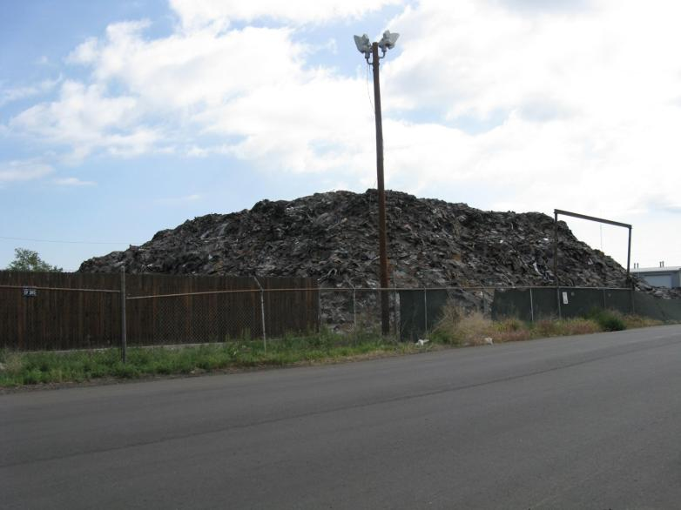
Estimated 8,000 tons of waste asphalt shingles abandoned

Slide 12
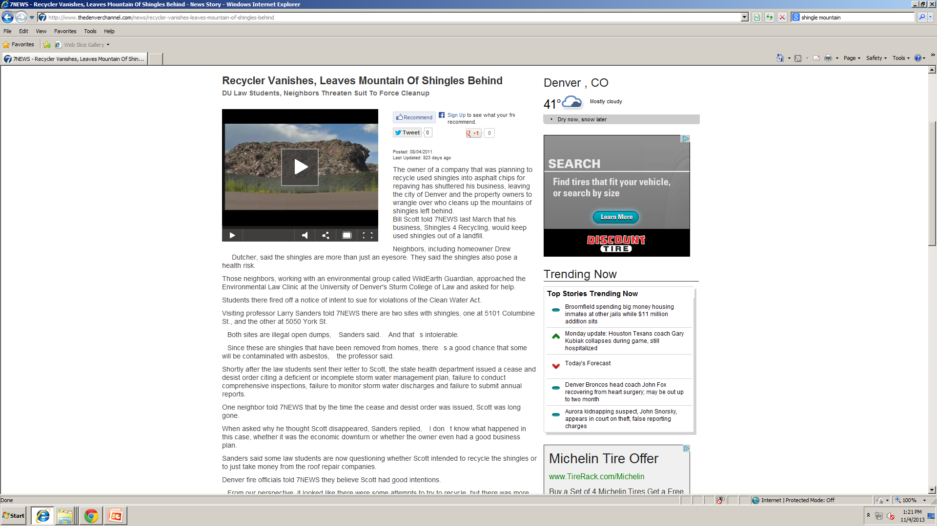

Slide 13
Enforcement
Compliance advisory issued by CDPHE to the facility operator and property owner to meet recycling turnover requirements, or remove all solid waste
Operator abandons the facility with all waste remaining on site
Property owner is also subject to the requirements of cleaning up the site

Slide 14
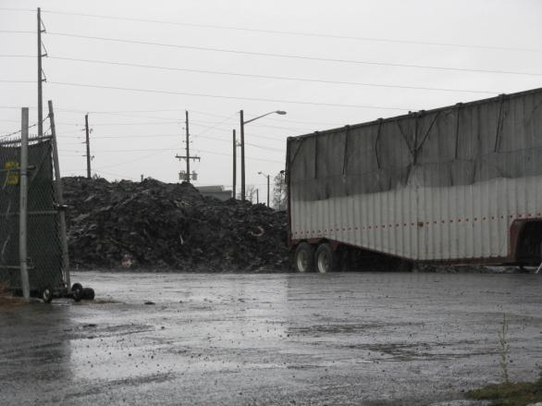
Clean Up Begins
Almost all material sent to the Landfill
Other single recycling operations at max capacity due to storms and saturated market of material
Clean-up costs for property owner for transportation and disposal tipping fees exceeded six digits figure

Slide 15
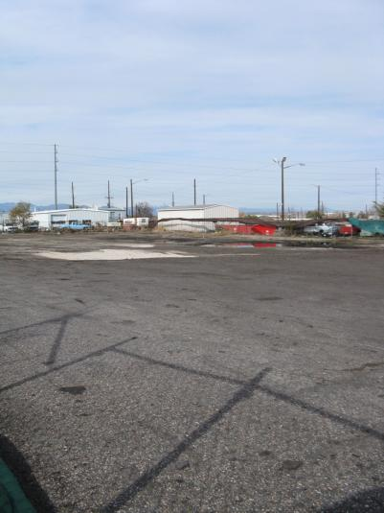
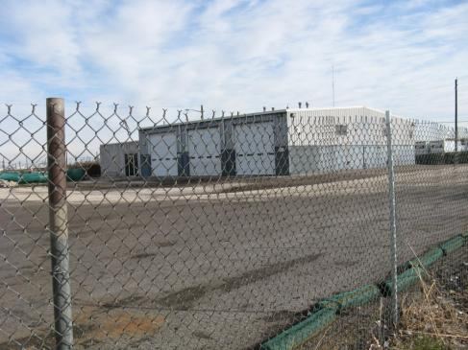
November 2011 NFA Letter Issued to Property Owner

Slide 16
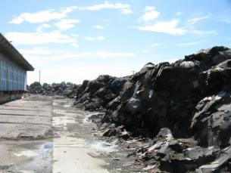
Abandoned Property Case 2
Denver, CO
Excessive stockpile of materials accumulated by unregistered “recycler”
Property owner takes ownership of waste shingle material to end terms of lease with operator
Property owner currently under compliance order for site clean-up

Slide 17
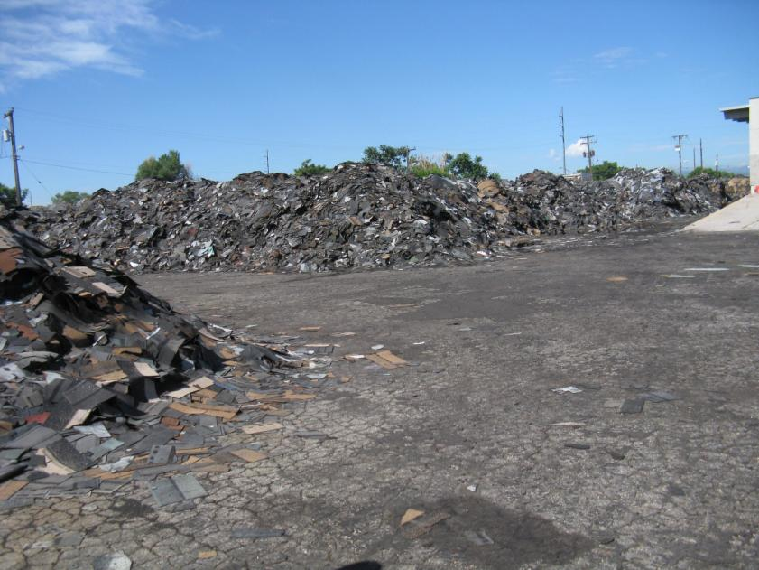

Slide 18
Abandoned Property Case 3
Colorado Springs, CO
Out of state shingle recycler offers new shingle recycling location (lower tipping fee then disposal)
Shingles are collected throughout summer roofing season
Operator stops paying rent and abandons waste shingle pile
Investigation in recycling company & operator turns up results in other states where the operator has abandoned shingle piles

Slide 19
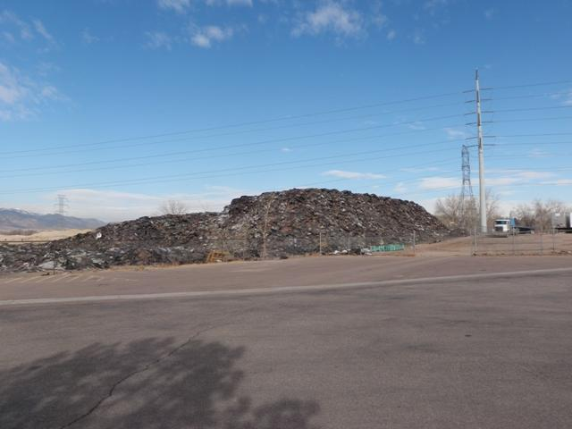

Slide 20
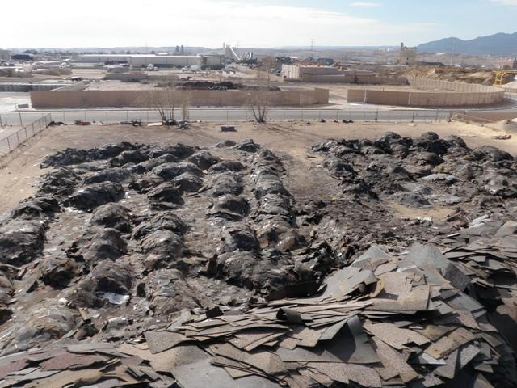

Slide 21
Clean-up & Cost, Who's Responsible?
Facility operators and property owners are both legally responsible for abandoned solid waste
Unfortunately, property owners frequently get stuck with clean up costs from sham recyclers
State has no emergency clean up funds for solid waste
Beyond civil regulatory penalties, there is ongoing and potential criminal enforcement for sham recycling operators

Slide 22
Lessons Learned
Make sure facilities have the required processing equipment (ex. Grinder) from the beginning… keep a close eye on operations with equipment being repossessed
Improve communications with local governments to keep up with new sites and unregistered operations
CDPHE revised the recycling facility regulations in 2012 to include a facility operations plan and closure plan
Consider perusing a revision to statute that would require financial assurance to recyclers that would cover clean up costs and reduce the occurrence of sham recycling operations
Industry - report questionable sites /sham recycling operations ASAP to the State and or County regulators as soon as possible to ensure they are held to the same standards for a level playing field

Slide 23
The Silver Lining
7 registered and operational asphalt shingle recycling facilities in Colorado
Over 25,000 tons of waste asphalt shingles processed and recycled during 2012 in Colorado

Slide 24
Thank You
Wolf Kray
Colorado Dept. of Public Health & Environment
Solid Waste & Materials Management Program
(303) 692-3337
wolfgang.kray@state.co.us

